Slide 1







Home
About
service
contact
SHIPPING
SOLUTION
FAST & RELIABLE
JAN 15 , 2026

Slide 2






HOME
ABOUT
SERVICE
CONTACT
SHIPPING REQUEST & TRACKING SYSTEM OVERVIEW
A dynamic ServiceNow-based shipping application that enables users to submit shipping requests, enter shipment details, and track their deliveries in real time through a live map tracker, while providing a streamlined and user-friendly experience.

Slide 3





HOME
ABOUT
SERVICE
CONTACT
THE RISE OF SOCIAL SHOPPING
STATISTICS
Over 70% of online orders now require real-time shipment tracking and delivery visibility
More than 60% of customers expect to track their shipments live from request creation to final delivery
DRIVERS
Demand for convenient digital shipping requests with minimal manual input
Need for real-time shipment tracking and status transparency

Slide 4



HOME
ABOUT
SERVICE
CONTACT
SHIPPING SOLUTION RULES
PRICING RESPONSIBLE
CUSTOMER
LOGISTICS

Slide 5





HOME
ABOUT
SERVICE
CONTACT
CUSTOMER
02
01
03
APPROVAL & COMMUNICATION
CUSTOMER REGISTRATION & REQUEST
Automatic email sent with shipping details and pricing
Customer can approve or reject the request with a rejection reason
TRACKING & DOCUMENTATION
Download shipping details at any time
Track shipment status and view live location
Supports both air and sea shipping
Self-registration on the platform
Create a shipping request with full shipment details

Slide 6


HOME
ABOUT
SERVICE
CONTACT
API-INTEGRATION
MYSHIPTRACKING

Slide 7






HOME
ABOUT
SERVICE
CONTACT
API-INTEGRATION

Slide 8
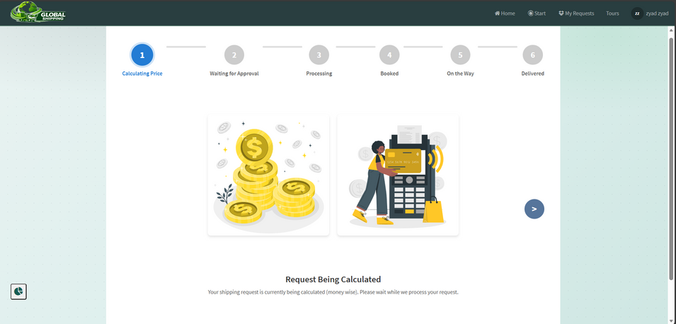
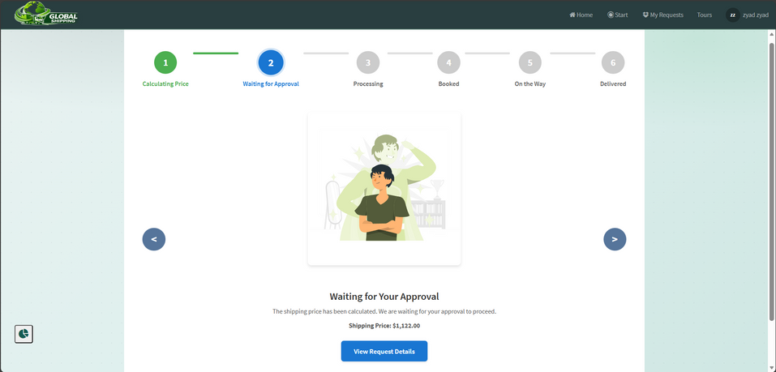
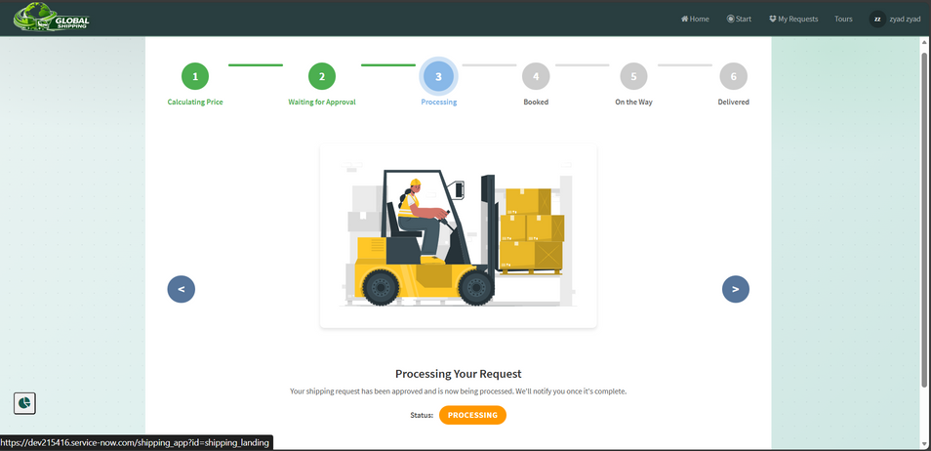
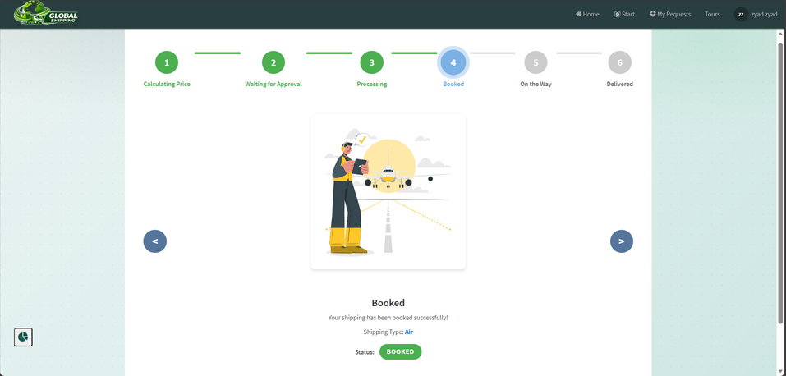
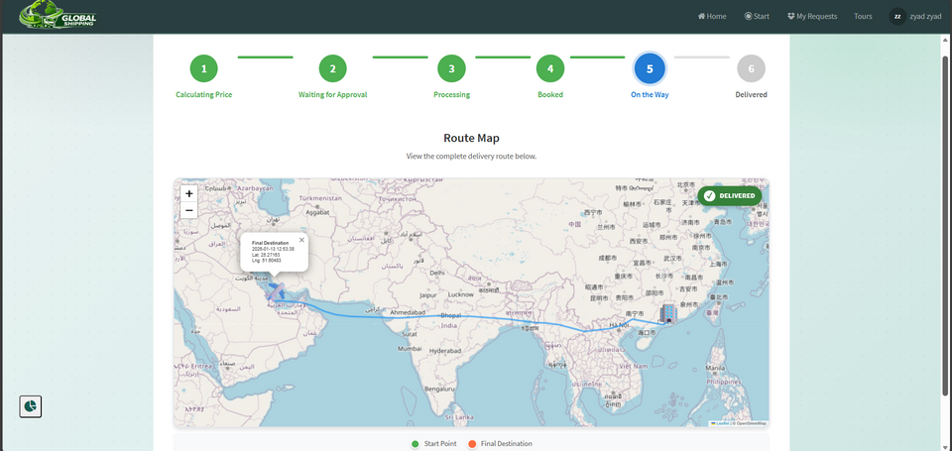
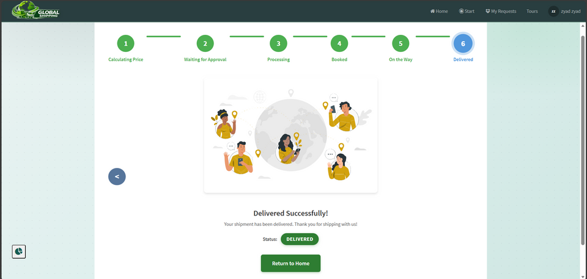
HOME
ABOUT
SERVICE
CONTACT
01
02
03
04
05
06

Slide 9
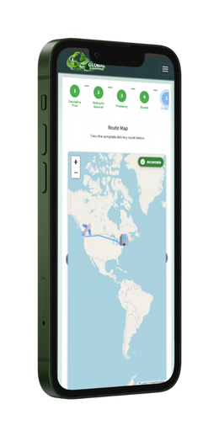
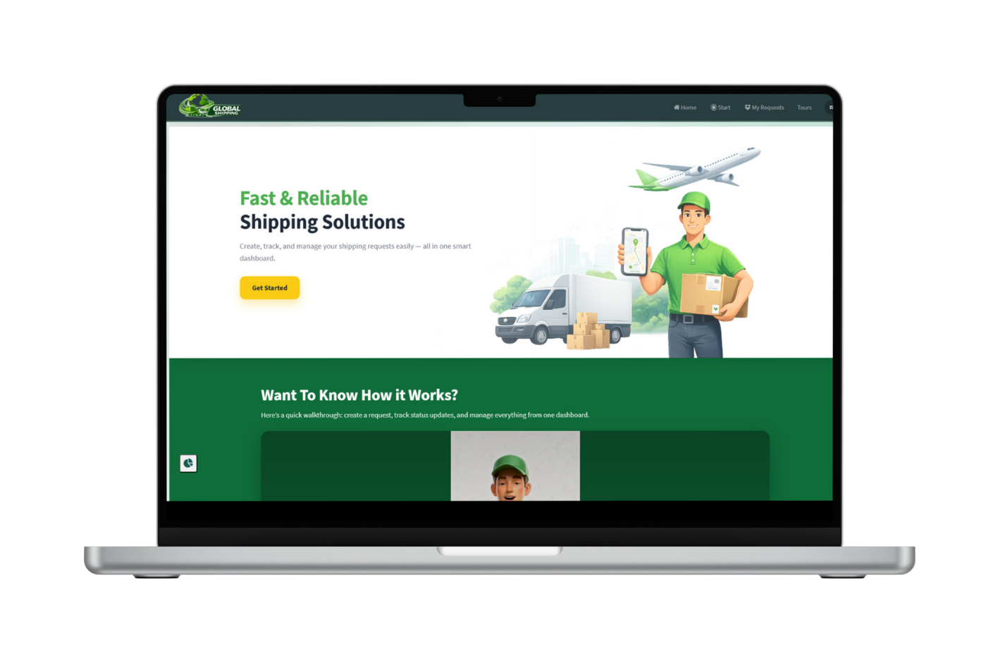
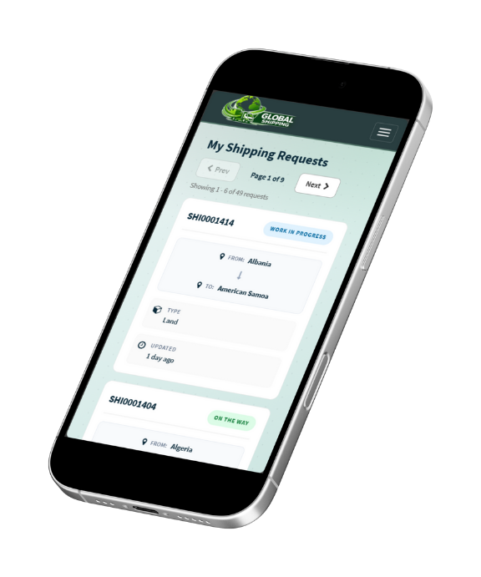
HOME
ABOUT
SERVICE
CONTACT
CUSTOMER
VIEW

Slide 10






HOME
ABOUT
SERVICE
CONTACT
PRICING RESPONSIBLE
REQUEST REVIEW
Receives the shipping request automatically
Reviews shipment details (type, route, cargo, priority)
PRICING SETUP
Calculates and sets the shipping price
Price is generated based on shipping method (air or sea) and shipment data

Slide 11
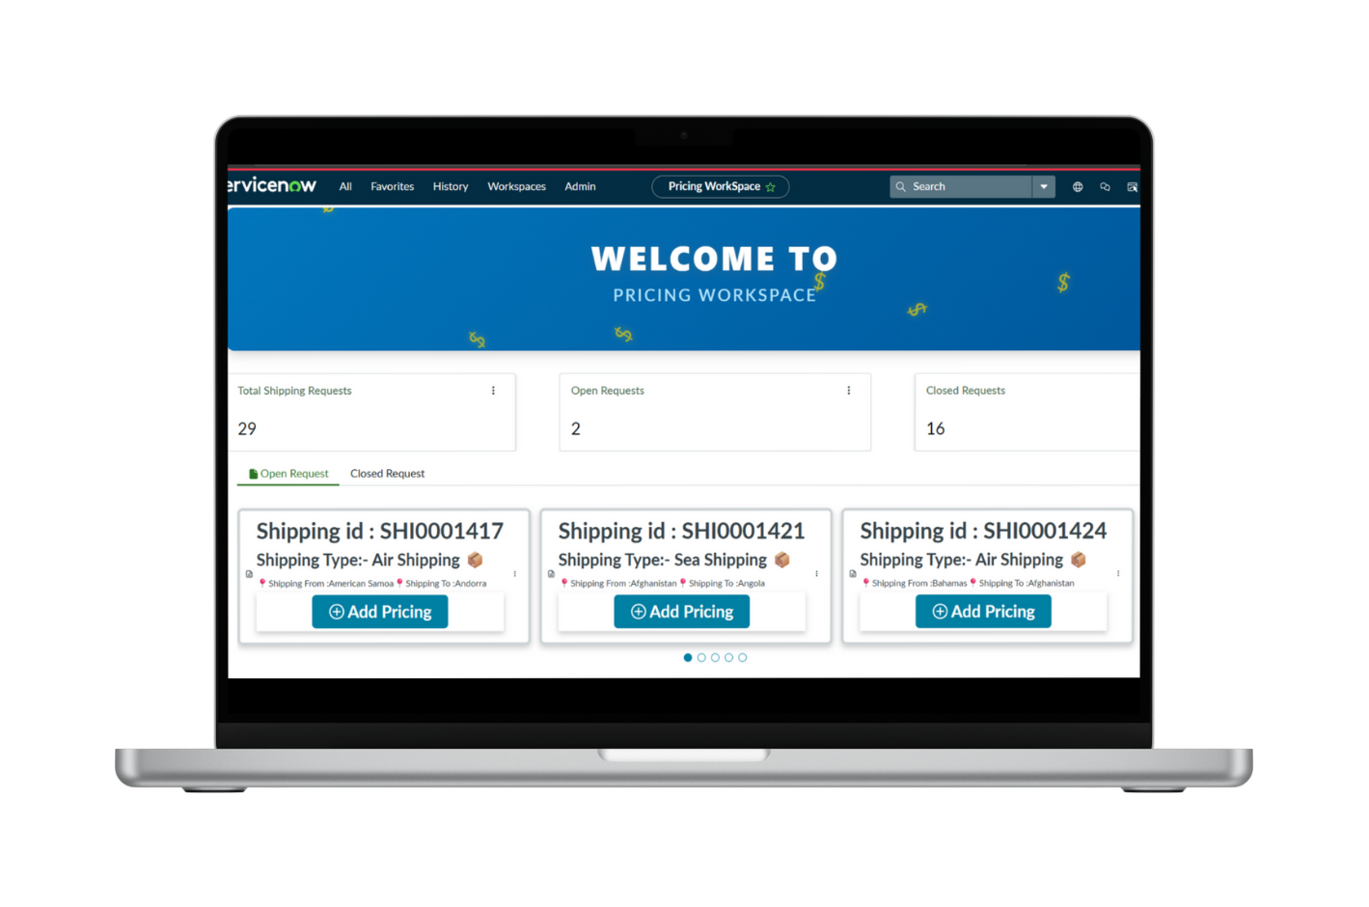


HOME
ABOUT
SERVICE
CONTACT
PRICING RESPONSIBLE
VIEW

Slide 12



HOME
ABOUT
SERVICE
CONTACT
LOGISTICS
REQUEST ASSIGNMENT
Receives approved shipping requests
Responsible for handling the shipment
View and review user-submitted issues.
LOGISTICS SCHEDULING
Sets the shipping start time
SHIPPING DETAILS
Updates transportation details
Air: Flight number
Sea: Vessel name
Land: Truck number

Slide 13

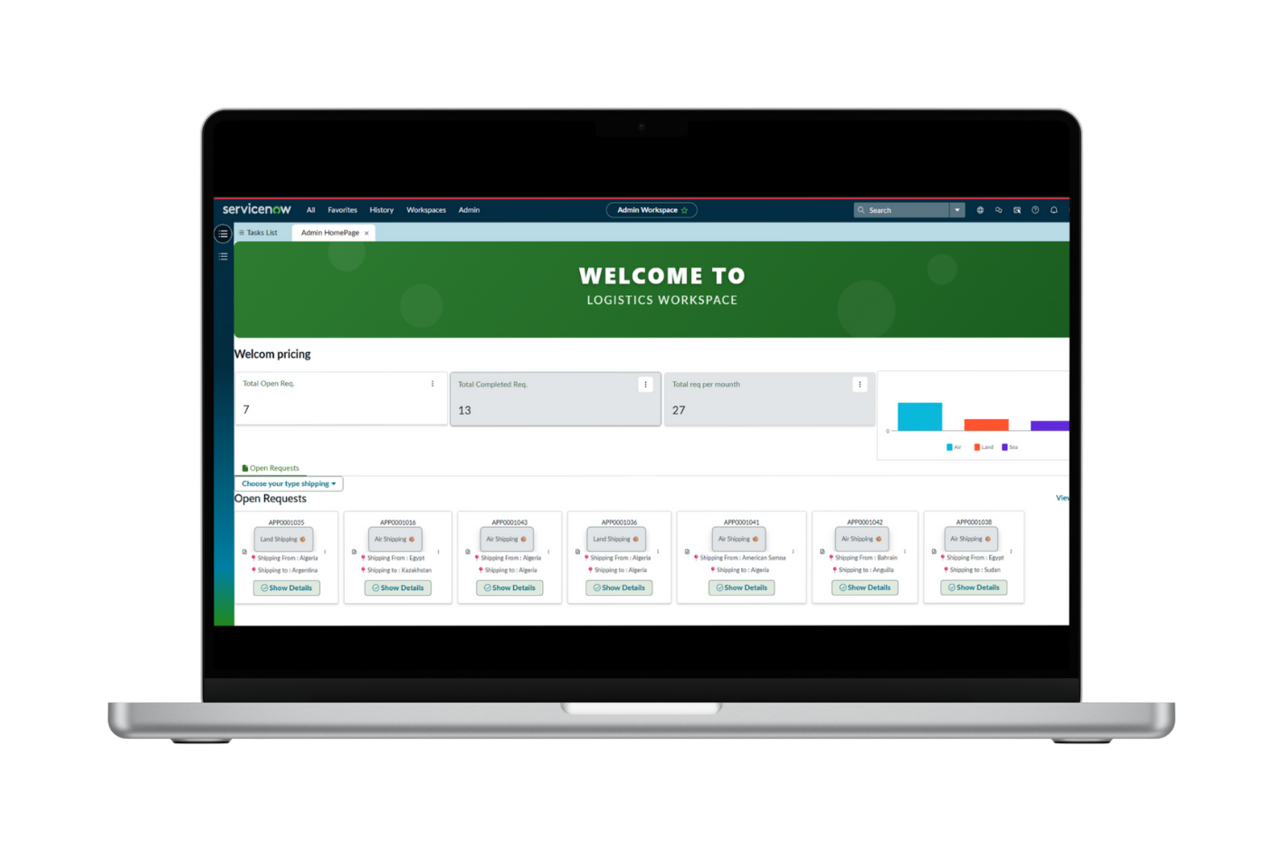
HOME
ABOUT
SERVICE
CONTACT
LOGISTICS VIEW

Slide 14




HOME
ABOUT
SERVICE
CONTACT
THANK YOU
CHECK IT OUT
OR
Click on me
Scan Me

